Slide 1

MINI PROJECT 2020-21 (15ECSW301) Meme Classification
Team : E5.
Guide : Dr P.G.Sunita Hiremath.
TEAM Members:
* Varun Bohara. 01fe18bcs278
* Sakshi Tahlani. 01fe18bcs271
* Abhishek Rao. 01fe18bcs297
* Madhurika Ganiger. 01fe18bcs284

Slide 2
OUTLINE
INTRODUCTION
MOTIVATION
PROBLEM STATEMENT
OBJECTIVES
LITERATURE SURVEY
PROPOSED METHODOLOGY
REQUIREMENT ANALYSIS
REFERENCES

Slide 3
INTRODUCTION
“Memes” are cultural inside jokes, a way of connecting with people across internet through instantly recognizable photos. They collect emotions, ideas and actions into an easy-to-translate format.
Rise of memes : Besides reflecting humour ,the rise of memes has shown to be having a harmful effect on an individual as well as political, religional , communal sectors of society.
Data: Meme as an image along with embedded text .
Features: Image and text features , in the form of embedding vetors .
Multimodal Models: Interpretation of memes using multimodal models .

Slide 4
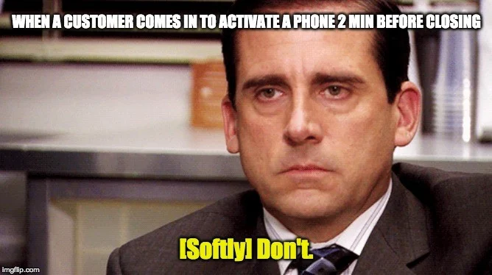
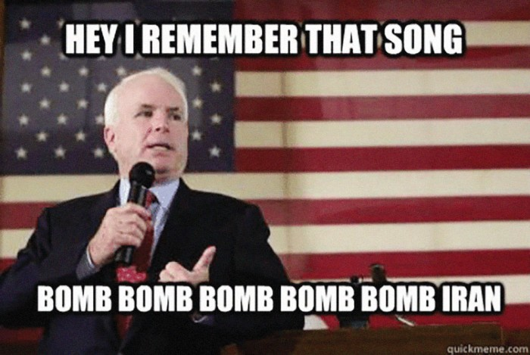

MOTIVATION

Slide 5


PROBLEM STATEMENT
To label a meme as hateful or non-hateful by creating a model that identifies multimodal hate speech in them.
Input
Output
Non Hateful(0)
Hateful(1)

Slide 6
OBJECTIVES
To generate embeddings of image and text .
To fuse the text and image embeddings and build a classifier.
To evaluate the performace of the multimodal model using AUC ROC.

Slide 7
LITERATURE SURVEY

Slide 8
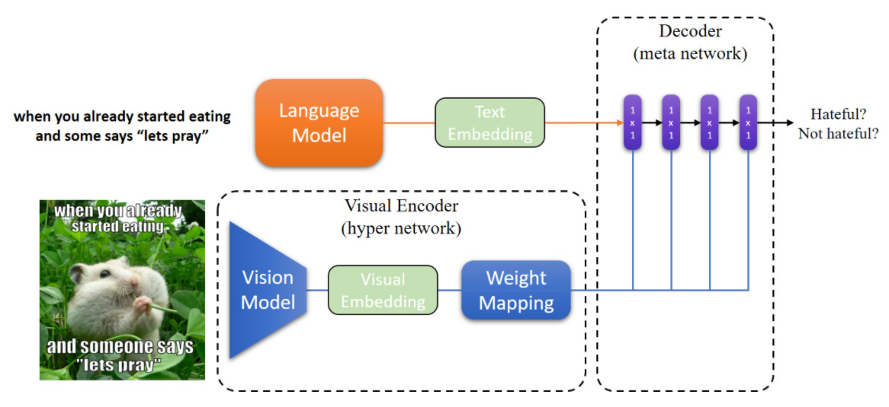
Hateful Memes Challenge 2020, SEP 22 Yuval Nirkin Assaf Rabinowitz Yoni Solel
Data Processing
Text embedding :SBERT
Image Embedding: MobileNetV2
Hypernetworks
Decoder
Varun Bohara

Slide 9
PROPOSED METHODOLOGY
Image Module
Input
Decoder
Performance Evaluation
Visual Module
Output
Hateful (1)

Slide 10
REQUIREMENT ANALYSIS
Functional
The model shall be able to generate image and text representations .
The model shall be able to classify the meme as hateful or non hateful using provided embeddings .
The model shall be able to generate the probability of the meme being hateful .
Non Functional
The model should be atleast 70% accurate .
The model should not under-perform on limited computing resources.

Slide 11
REFERENCES
https://nirkin.com/hateful-memes/

Slide 12

Hypernetworks
In a typical deep network , the majority of parameters are in the kernels of convolutional layers.
Each kernel contain N_{in} × N_{out} filters and each filter has dimensions f_{size} × f_{size}.
For each layer j, the hypernetwork receives a layer embedding z^{j} ∈ R^{Nz} as input and predicts K^{j}, which can be generally written as follows:
K^{j} = g(z^{j} ), ∀j = 1, ..., D
K¹
...........
K^{D}
N_{in}.f_{size}×N_{out}f_{size}
N_{in}.f_{size}×N_{out}f_{size}

